Slide 1


INNOVACT 2025
TRACK: IoT
PROBLEM: SMART PLANT MONITORING WITH IoT
YUKTI ID:IR2025/996013

Slide 2


404 Found
ARATRIK TEWARI
SAPTARSHI DAS
SHYALONA GHOSH
AYUSH SAXENA
PARITOSH SINGH

Slide 3
PROBLEM STATEMENT
To create an IoT-powered plant pot that monitors the soil moisture, sunlight and temperature to ensure optimal growth of the plant. This alerts the user when the plant requires any of the above mentioned factors, making it easier to care for it without constant attention.

Slide 4
PROPOSED SOLUTION
MAIN IDEA: To measure the moisture of soil, temperature and light intensity using Arduino sensors and alerting the user if the plant does not meet the optimal growth conditions.
WHY IS IT RELEVANT? Water conservation, good for amateur gardeners, very useful for enthusiastic gardeners who have a busy lifestyle, helpful for elderly people with low mobility.
WHY IS IT INNOVATIVE? remote monitoring, user friendly features

Slide 5
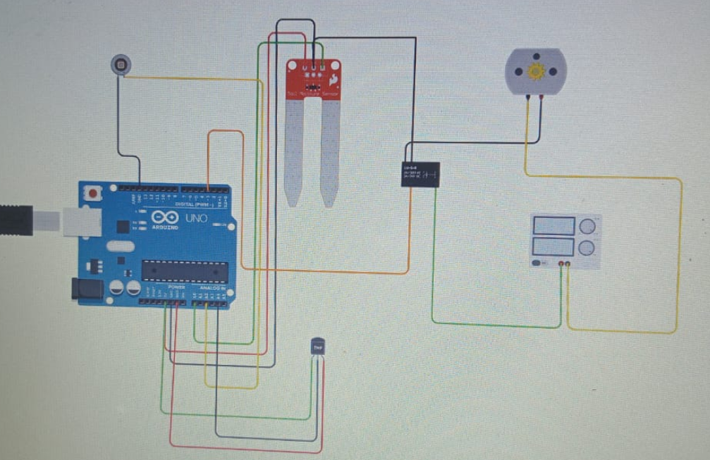
TECHNICAL APPROACH
APPARATUS USED: Temperature Sensors (LM35CAZ),UV Sensor ML8511,Ardino Uno(microcontroller board with USB cable),Jumper Wires(male to female and male to male)
WORKFLOW DIAGRAM:

Slide 6
IMPLEMENTATION DETAILS
.
KEY FEATURES:
Automated Care – Monitors soil moisture, temperature & water needs, reducing manual effort.
Easy to Use – Simple plug-and-play setup with minimal maintenance, ideal for amateurs.
Smart Notifications – Provides timely alerts/reminders, ensuring plants stay healthy.
User Benefits – Saves time & effort while improving indoor air quality, comfort & well-being.

Slide 7
UTILITY OF THE PROPOSED SOLUTION
Elderly people: Since elderly people have low mobility, it is difficult for them to continuously monitor the plant so this is a very good alternative and helps them rest.
Water conservation: Prevents excessive wastage of water and it also prevents accidently killing the plant by overwatering, which is the single most reason indoor plants die.
Beginner friendly: Perfect for amateur gardeners who often overwater their plant and keep them in too much sunlight and therefore kill it.
Optimized lifestyle: Enthusiastic gardeners who have a busy lifestyle often cannot focus much on their hobby, so this provides a great alternative to that they do not have to monitor their plants constantly and it prevents ignorance.

Slide 8
FUTURE SCOPE
Integration with IoT & Mobile Apps : Remote monitoring and control through smartphones.
AI-Based Plant Care : Smart suggestions for plant type, watering cycles, and growth tracking.
Scalability : Adaptable for larger setups like offices, balconies, and urban farms.
Sustainability Impact : Contributes to greener cities, reduced carbon footprint, and improved urban biodiversity.

Slide 9
CONCLUSION
Why does it stand out? Holistic Solution – Goes beyond monitoring to provide automated care + smart guidance. Designed for Urban Users – Specifically addresses the challenges of busy city lifestyles. Accessible to All – Simple, affordable, and user-friendly, even for first-time plant owners.

Slide 10
ACKOWLEDGEMENT
VIT Vellore for providing us with this incredible platform to innovate and showcase our ideas.
The InnovAct 2025 Organising Committee & Faculty Coordinators for their constant support, guidance, and smooth execution of the event.
Our mentors and judges, for their valuable feedback and encouragement.
And finally, my teammates, for their dedication, creativity, and collaboration throughout this journey.

